Slide 1


HANGMAN
with the
PAST
SIMPLE

Slide 2
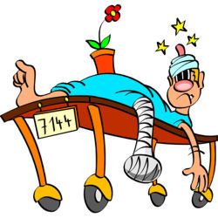



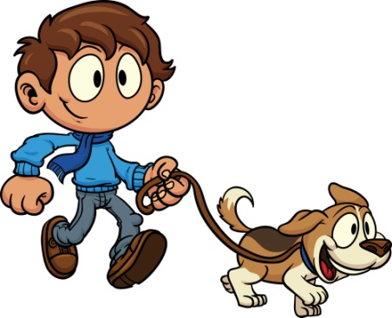
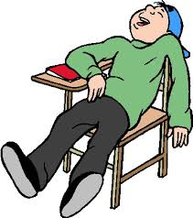

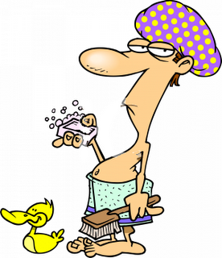

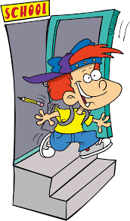
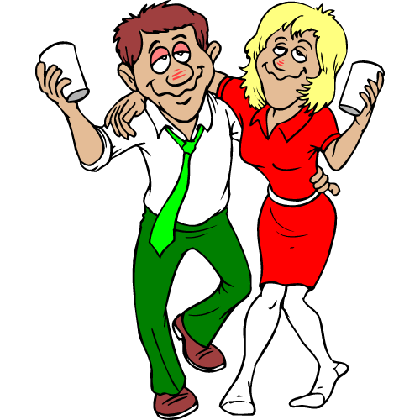
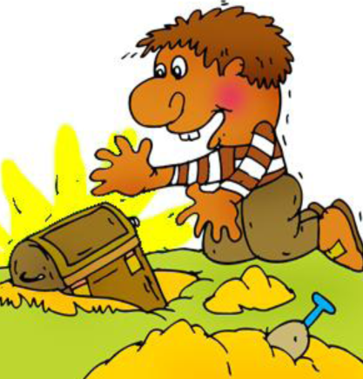
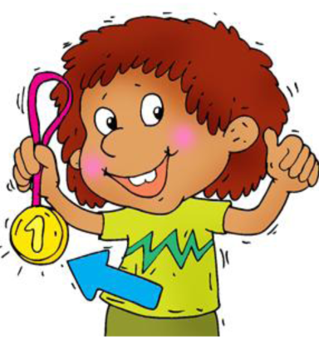
UPS - Click the picture and try
again

Slide 3
A
B
C
D
E
F
G
H
I
J
K
My father
…………………
to work on foot last Monday.
W
E
N
T
L
M
N
O
P
R
S
T
U
W
Y

Slide 4
A
B
C
D
E
F
G
H
I
J
K
Michael
……….. a car accident and
…………………
his leg.
H
A
D
B
R
O
K
E
L
M
N
O
P
R
S
T
U
W
Y

Slide 5

A
B
C
D
E
F
G
H
I
J
K
Richard
…………………
his dog in the afternoon.
W
A
L
K
E
D
L
M
N
O
P
R
S
T
U
W
Y

Slide 6
A
B
C
D
E
F
G
H
I
J
K
Last night he
…………………
a strange noise.
H
E
A
R
D
L
M
N
O
P
R
S
T
U
W
Y

Slide 7
A
B
C
D
E
F
G
H
I
J
K
My brother
…………………
asleep in class yesterday.
F
E
L
L
L
M
N
O
P
R
S
T
U
W
Y

Slide 8
A
B
C
D
E
F
G
H
I
J
K
My friend Joe
…………………
hard for his Math test.
S
T
U
D
I
E
D
L
M
N
O
P
R
S
T
U
W
Y

Slide 9
A
B
C
D
E
F
G
H
I
J
K
Brian
…………………
a shower in the morning.
T
O
O
K
L
M
N
O
P
R
S
T
U
W
Y

Slide 10
A
B
C
D
E
F
G
H
I
J
K
My uncle
…………………
his Christmas gifts at the weekend.
B
O
U
G
H
T
L
M
N
O
P
R
S
T
U
W
Y

Slide 11
A
B
C
D
E
F
G
H
I
J
K
Samuel
…………………
school at one yesterday.
L
E
F
T
L
M
N
O
P
R
S
T
U
W
Y

Slide 12
A
B
C
D
E
F
G
H
I
J
K
They
…………………
too much at the party.
D
R
A
N
K
L
M
N
O
P
R
S
T
U
W
Y

Slide 13

A
B
C
D
E
F
G
H
I
J
K
Tom
…………………
a chest in his backyard.
F
O
U
N
D
L
M
N
O
P
R
S
T
U
W
Y

Slide 14
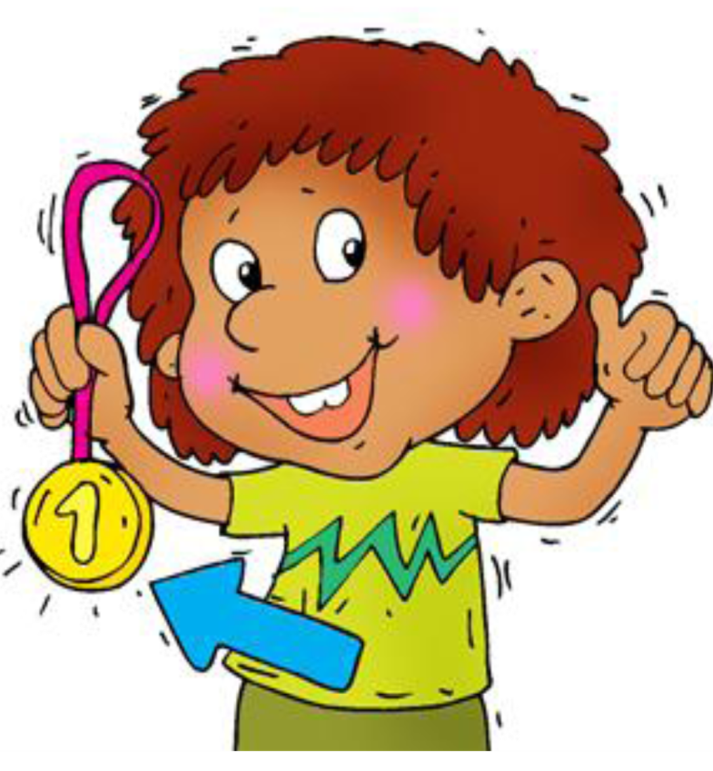
A
B
C
D
E
F
G
H
I
J
K
He
…………………
the first place in the competition.
W
O
N
L
M
N
O
P
R
S
T
U
W
Y

